Slide 1
GeoGuessrAI
Nirvan S.P. Theethira (001)
Notes:
GeoGuessr

Slide 2
GeoLocation
Identification or estimation of real-world location using geographic data.
Location based data : satellite images, sensor data, traffic movement data, pollution data etc.
Inferring the location of a tracked animal based on sensors attached to the animal.:
time history of sunlight brightness
water temperature
depth measured.
Humans are not great at sensor data they excel at Image data.

Slide 3
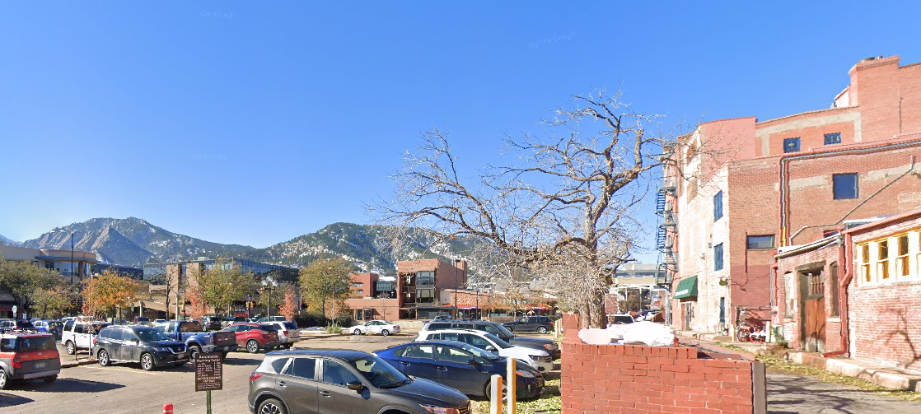
Where is this ? And how did you find it ?
Redlands, CA ?
Boulder, CO ?
Champaign, IL ?
Madison, WI ?
Mountains ?
Snow ?
Architecture ?
Vehicles ?
Vegetation ?

Slide 4
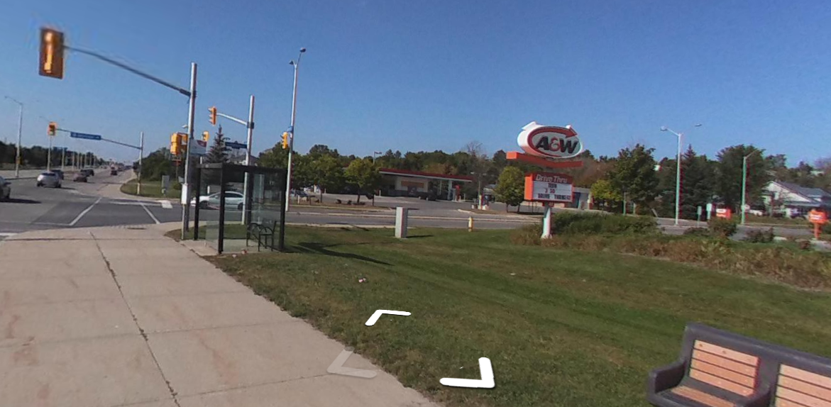
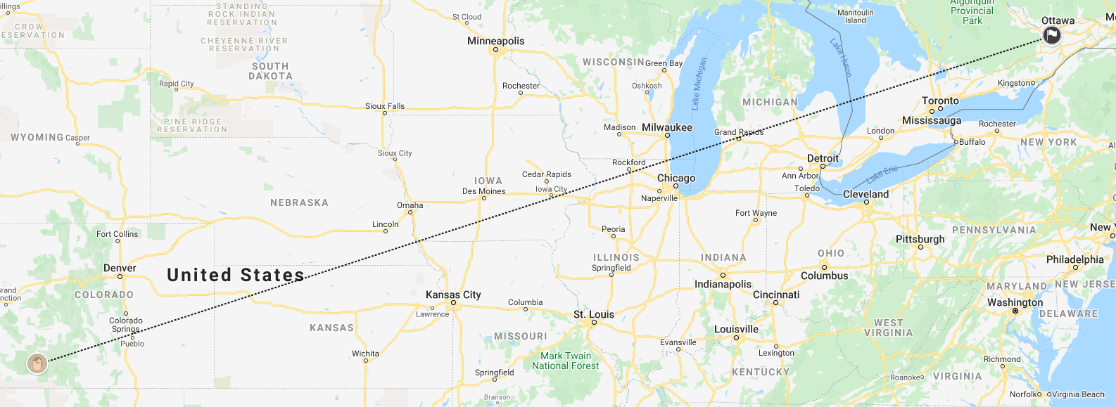
GeoGuessr
Given a street view find the location.
Scored based on distance from target location.
Human players use weather, vegetation, architecture etc.
Human players can also use prior knowledge.
The project hopes to use AI for the above task.

Slide 5
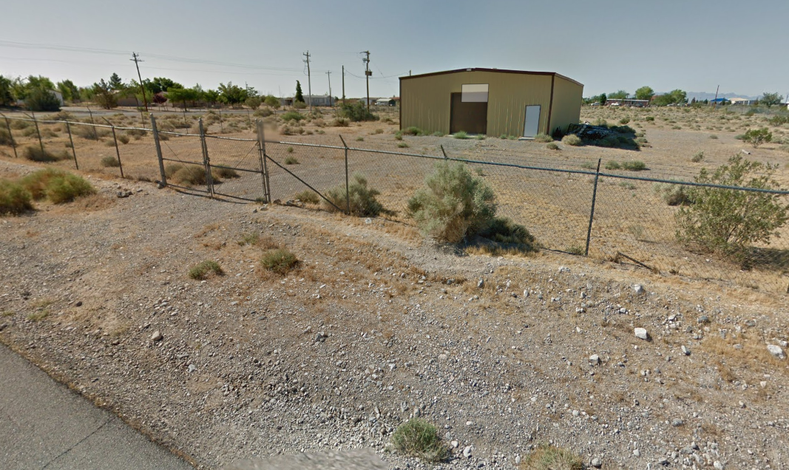
Region of study
Restricted to the map of the US.
US has diverse geographic landscape with definitive features in each region.
Large amount of google street view data.
Makes training easier.

Slide 6
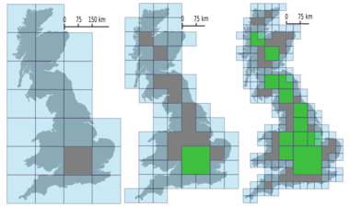
Data collection
Map is split up into square grids using google S2 geometry.
Street view images are queried from each grid using google maps API. 2000/day limit
Size of square grids and number of images queried per grid are hyper-parameters.
360 degree street view allows query of multiple images per location.

Slide 7
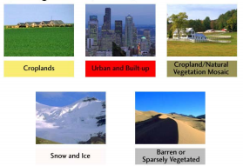
K-NN
The unsupervised learning algorithm is used to cluster similar data.
The goal is to cluster data such that similar locations fall into similar clusters.
A new datapoint is assigned probabilities based on how close it is to location clusters.
The idea is taken from IMG2GPS [1]

Slide 8
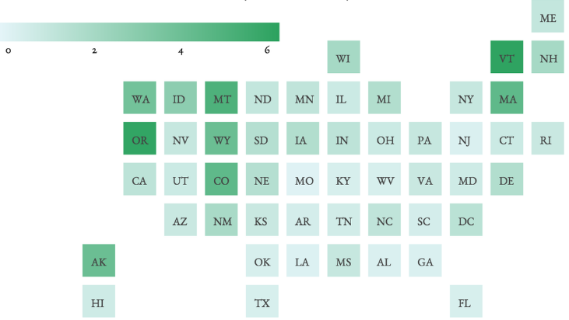
CNN
Uses single image per location to train a CNN.
CNN gives a softmax output of predictions across all grids.
This idea is taken from PlaNet [2]

Slide 9
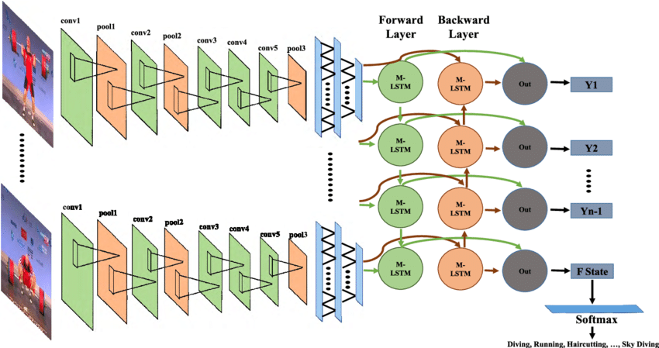
Sequential LSTM/CNN
360 degree street view allows query of multiple images per location.
Multiple images per location are first passed through a CNN to get a vector representation.
The image vectors are sequentially processed by a LSTM to give a softmax output
This idea is taken from PlaNet [2]

Slide 10
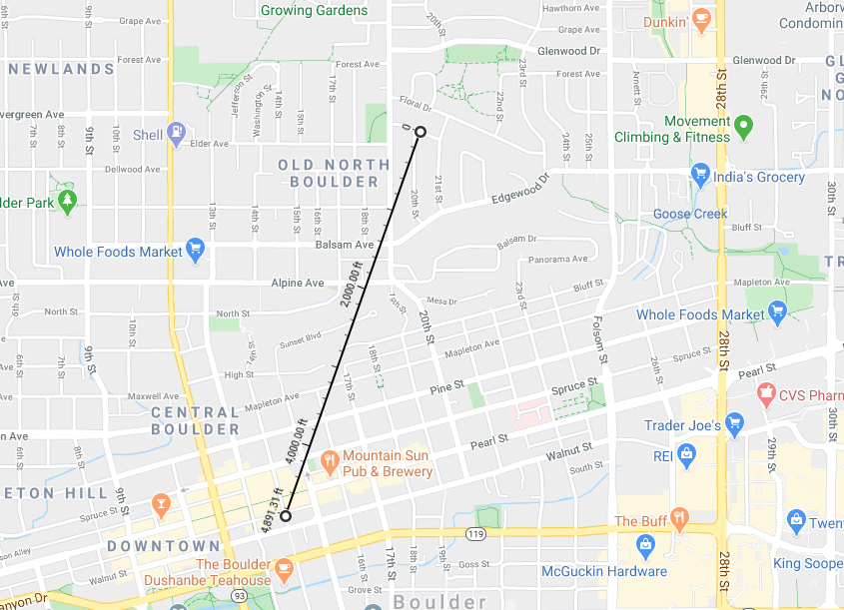
Evaluation
Euclidean distance between prediction and target is used for evaluation.
Top 10 softmax output are considered.
Human scores are used as baseline.

Slide 11
References
[1] James Hays and Alexei A. Efros. 2008. im2gps:estimating geographic information from a single image.In Proceedings of the IEEE Conf. on Computer Vision and Pattern Recognition (CVPR).
[2] Tobias Weyand, Ilya Kostrikov, and James Philbin. 2016.PlaNet - Photo Geolocation with Convolutional Neural Networks. CoRR abs/1602.05314 (2016). http://arxiv.org/abs/1602.05314

